Slide 1
Capstone Project 1
Predicting price of Boston housing dataset

Slide 2
For whom it will be useful
1 Real Estate Companies
2 Room rental Companies

Slide 3
Data Acquisition
1 Source of Data - UCI machine learning repository (Boston housing data)
2 Features of Data
CRIM per capita crime rate by town
ZN proportion of residential land zoned for lots over 25,000 sq.ft.
INDUS proportion of non-retail business acres per town
CHAS Charles River dummy variable (= 1 if tract bounds river; 0 otherwise)
NOX nitric oxides concentration (parts per 10 million)
RM average number of rooms per dwelling
AGE proportion of owner-occupied units built prior to 1940
DIS weighted distances to five Boston employment centres
RAD index of accessibility to radial highways
TAX full-value property-tax rate per $10,000
PTRATIO pupil-teacher ratio by town
B 1000(Bk - 0.63)^2 where Bk is the proportion of blacks by town
LSTAT % lower status of the population
MEDV Median value of owner-occupied homes in $1000's

Slide 4
Data Cleaning
Data was clean, some cleaning was required after converting to a .csv file from excel

Slide 5
Models used
1 Linear Regression Model
2 Decision Tree Model
3 Random Forest Model
4 Random Forest with features importance

Slide 6
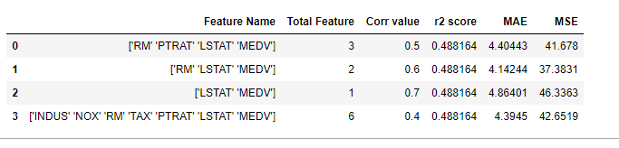
Linear Regression Model
We took different number of features depending on the correlational value and compared the errors
we can see the table above and compare which values of threshold is good.
Here we can see by the best performance is when we have a threshold value of 0.6.

Slide 7
Decision Tree Model
Here we choose based model (with default parameters)
Then did hyperparameter tuning with
1 Randomised gridsearchCV
2 GridsearchCV
And compared the improvement in the model
We can see that the base model performed better, but because on CPU constraints we couldn't increase the grid space.
Model | Average Error (degree) | Accuracy
Base Model | 2.53 | 86.07%
Randomised gridsearchCV | 2.70 | 85.49
GridsearchCV | 2.58 | 85.61

Slide 8
Random Forest Model
Here too we had the same approach as decision tree, we choose based model (with default parameters)
Then did hyperparameter tuning with
1 Randomised gridsearchCV
2 GridsearchCV
And compared the improvement in the model
We can see that after GridsearchCV our model has performed better.
Model | Average Error (degree) | Accuracy
Base Model | 2.47 | 86.63%
Randomised gridsearchCV | 2.03 | 89.63
GridsearchCV | 1.98 | 89.83

Slide 9
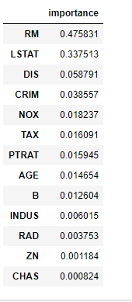
Random Forest with features importance
In the image to the right we can see how each feature is important for the target variable. So took different number of features and compared their improvement with base model
Number of features | Improvement (%)
1 | -16.17
2 | -4.57
3 | -1.24
4 | 0.95
5 | 3.11%
6 | 3.62

Slide 10
Random Forest with features importance (continued)
Number of features | Improvement (%)
7 | 3.79
8 | 4.09
9 | 3.85
10 | 3.88
11 | 3.89
12 | 3.58
13 | 3.56
From the table we can see that the model performed best with 8 features
This the highest improvement that we got from all the above models

Slide 11
Model Comparisions
Models | Avg error(degrees) | Accuracy(%) | Comparison wrt Base model
Decisiontree Base model | 2.5373 | 86.07%
Decisiontree Randamised search CV | 2.7073 | 85.49% | -0.68%
Decisiontree Grid search CV | 2.5857 | 85.61% | -0.54%
Randomforest Base model | 2.4733 | 86.63%
Randomforest Randamised search CV | 1.9917 | 89.87% | +3.74%
Randomforest Grid search CV | 1.9957 | 89.97% | +3.65%
Randomforest (.feature_importances_) | 1.8952 | 90.17% | +4.09%

Slide 12
Conclusion
After comparing the above models the best model with highest accuracy of 90.17% was Randomforest (.feature_importances_) with first 8 features being selected.
.
THANK YOU

